Slide 1
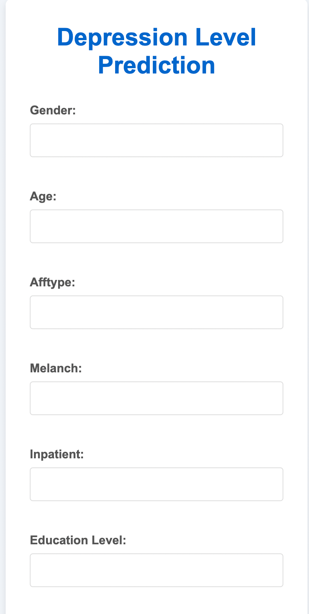
Depression Diagnosis
A Data-Driven Approach to Mental Health Prediction
Submitted By:
Anahit Sandhu, 102203625
Pehu Bhatia, 102203977

Slide 2
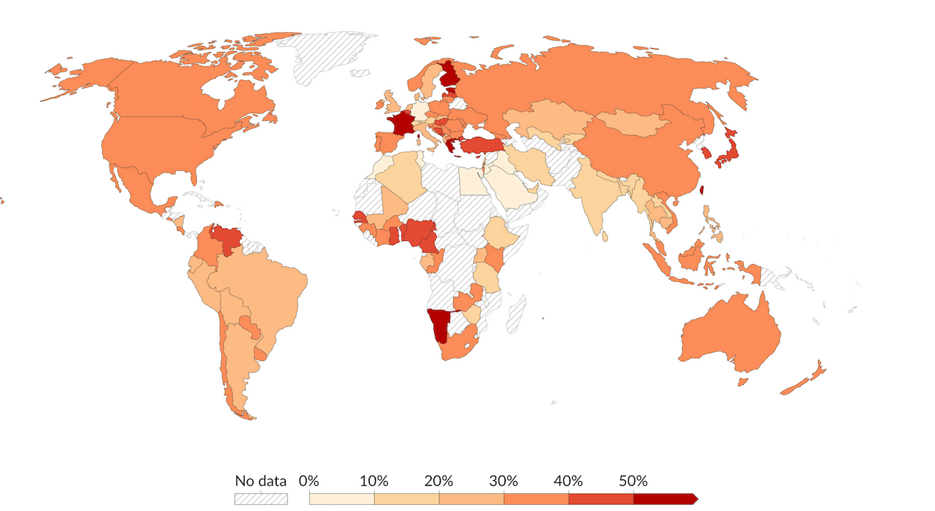
Why Depression Diagnosis?
In today’s world, depression has become an uprising problem. It is not the problem itself but the taboo around it that makes it more dangerous. People tend to shy away from going to a psychologist and end up living their whole lives without a diagnosis
This calls for a way to diagnose these problems without any “shame”. Our model does exactly that using machine learning to predict depression .
Fig: perceived discomfort speaking about anxiety or deperssion

Slide 3

Diagnosing depression severity is complex and subjective
To combat this problem, the following needs to be done:
Create a reliable ML model
A reliable ML model ensures correct predictions at a high accuracy
Categorize depression into severity levels.
Our model divides depression into 4 categories:
no depression, mild depression, moderate depression and severe depression
Identify significant predictors
Selecting the important features that predict the outcome is important for maximum efficiency

Slide 4
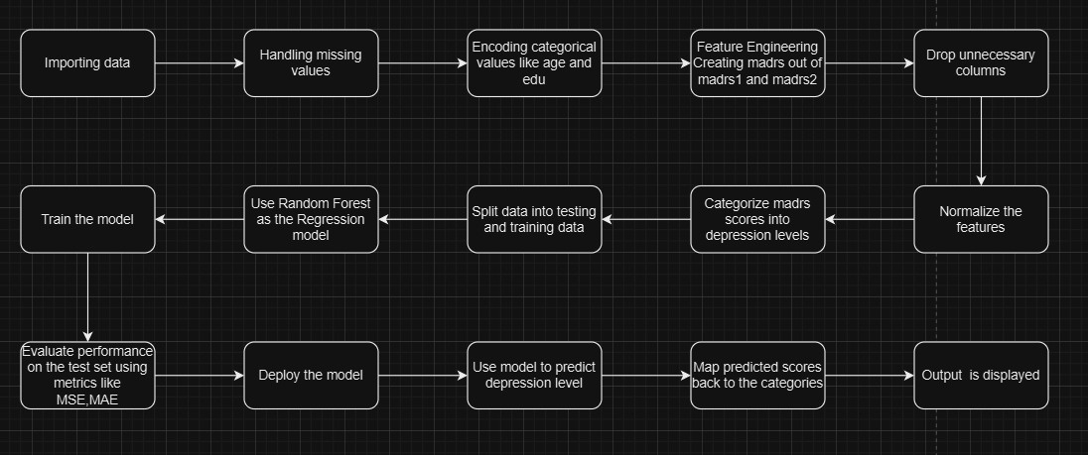
Project Flow
The key steps: Data collection, preprocessing, feature engineering, model training, and evaluation.

Slide 5
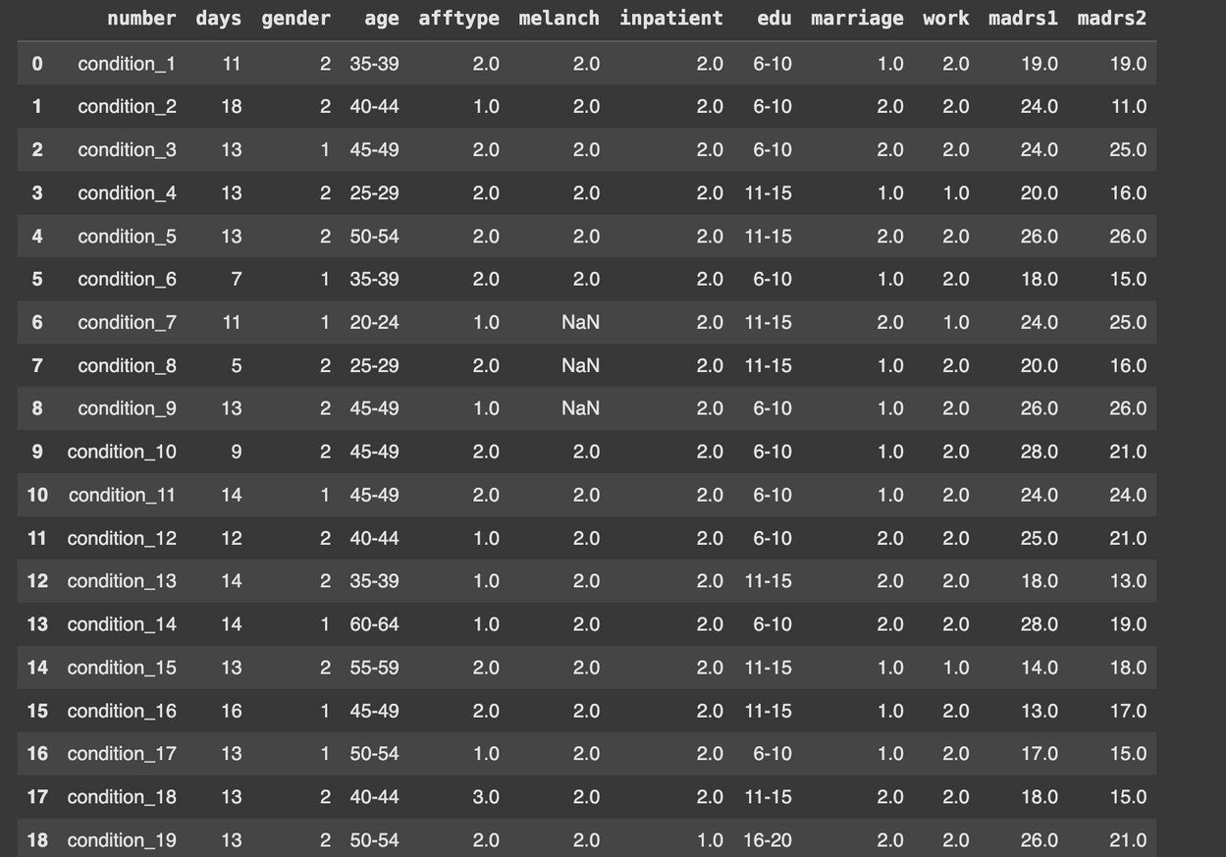
Dataset
Our dataset contains two folders: one for the controls and one for the condition group. A CSV file containing the actigraph data collected over time has been provided for each patient.
The final dataset used is the combined data for the control and condition group called scores. The columns include days, gender, age, afftype, melanch, inpatient, education, marriage, work, madrs1 and madrs2
Our target variables are madrs1 and madrs2. These scores convey the severity of depression and help us predict the final diagnosis
Link for the dataset: https://www.kaggle.com/datasets/arashnic/the-depression-dataset/data

Slide 6
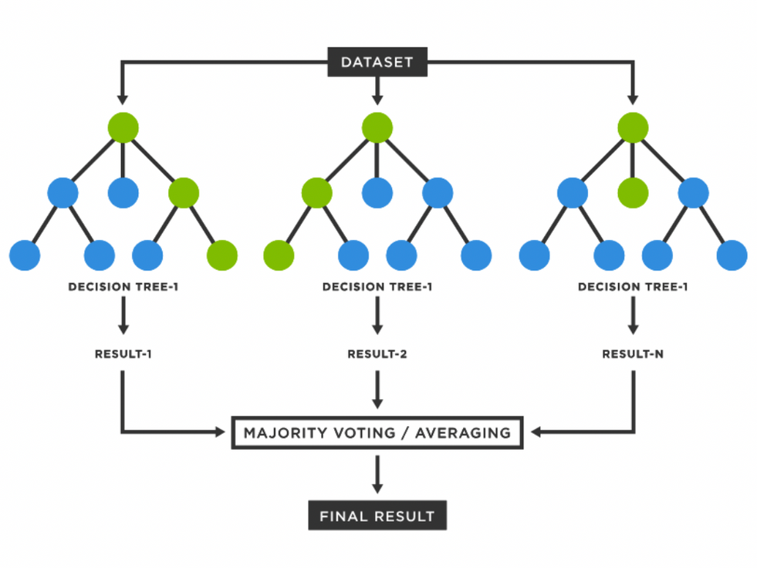
Random Forest Algorithm
We have used the Random Forest Algorithm to train our model. This Algorithm is an ensemble learning technique in machine learning that is used for classification and regression purposes.
It uses the training data to create multiple decision trees; each tree comprises a random subset of the data.
It is robust to noise, requires minimal preprocessing, and supports parallel training, enhancing computational efficiency.

Slide 7
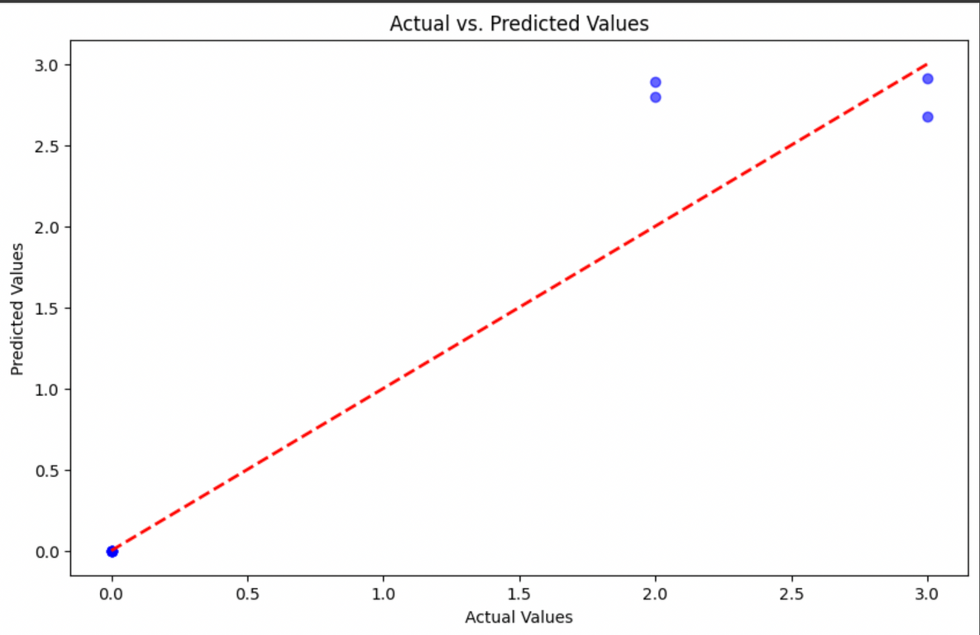
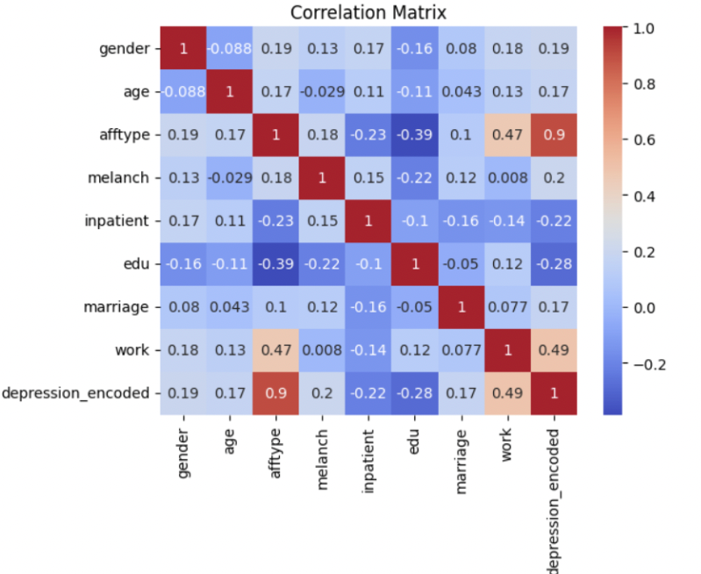
Result
Performance Metrics:
Mean square error(0.1402363636363636), Mean absolute error(0.1909090909090909), and R² score (0.9087709677419354) gave high values over the test dataset, which means it is a robust predictor.

Slide 8
The model assisted in pattern recognition within clinical and demographic data that could be differentiated into various levels of depression; it provides a precious aid for clinical assessments.
The model effectively predicts depression severity levels.
Predictions
Potential Clinical Utility
Conclusion
Significant Variables
Significant variables contributing to predictions include marriage, employment, education, gender,etc.

